Slide 1
tide gauge
satellite
altimeter
sea level
bottom pressure sensor
land movement
geodetic reference

Slide 2
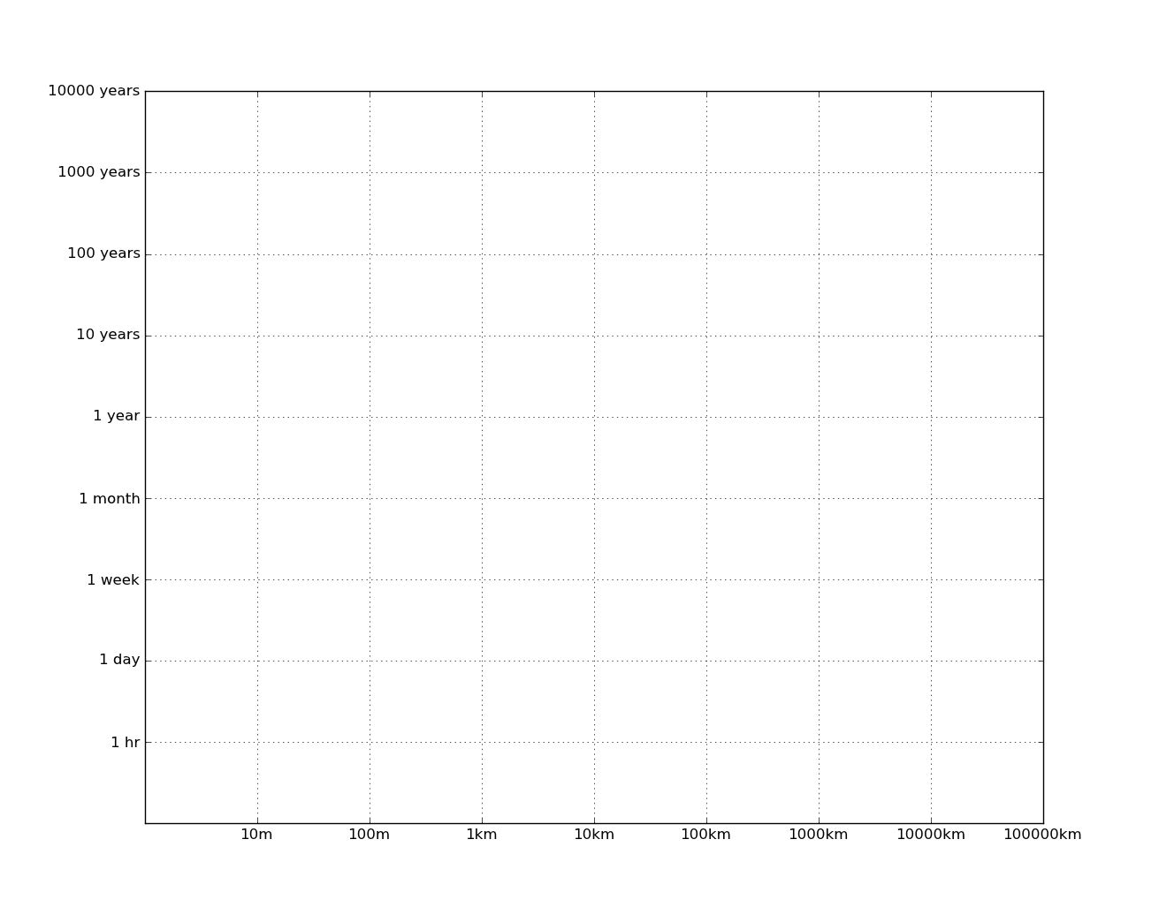
bathymetry/geology
climate change
ENSO, PDO
seasonal
long period tides
eddies &
fronts
coastally trapped waves
internal tides
[semi] diurnal
surface tides
internal waves & inertial motions
surface waves

Slide 3
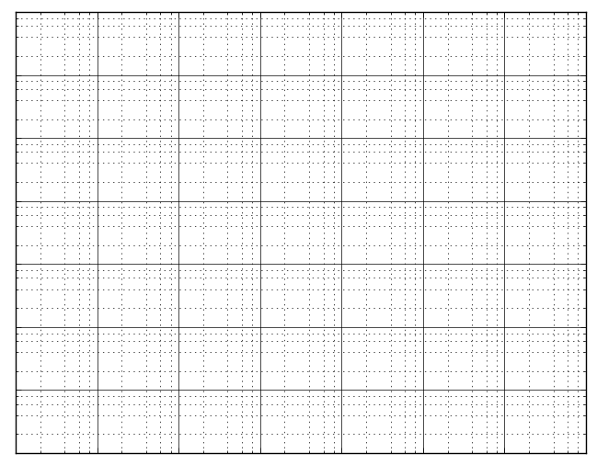

Slide 5
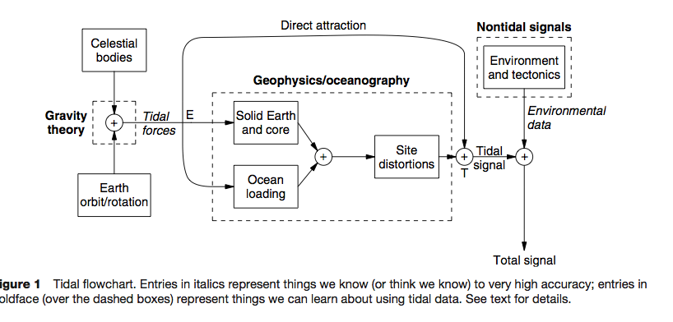
Positional Astronomy & Gravity
Geophysics/Oceanography
Non-Tidal Forces
Ocean Self Attraction
Ocean Loading
Earth orbit & rotation
Non-Tidal Ocean
SAL
Moon orbit
ATGF
Solid Earth & Core
Nett Tidal Force
Tidal Ocean
Sun orbit
Ocean Observation

